Slide 1

Azure Cosmos DB Workshop
Notes:
Labs
https://docs.microsoft.com/en-us/azure/cosmos-db/sql-api-get-started

Slide 2

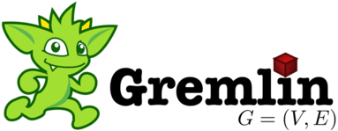




Azure Cosmos DB
A globally distributed, massively scalable, multi-model database service
MongoDB
Table API
Column-family
Document
Key-value
Graph
Elastic scale out
of storage & throughput
Guaranteed low latency at the 99th percentile
Five well-defined consistency models
Turnkey global distribution
Comprehensive SLAs
Notes:
Azure Cosmos DB offers the first globally distributed, multi-model database service for building planet scale apps. It’s been powering Microsoft’s internet-scale services for years, and now it’s ready to launch yours.
Only Azure Cosmos DB makes global distribution turn-key.
You can add Azure locations to your database anywhere across the world, at any time, with a single click. Cosmos DB will seamlessly replicate your data and make it highly available.
Cosmos DB allows you to scale throughput and storage elastically, and globally! You only pay for the throughput and storage you need – anywhere in the world, at any time.
Multi-API

Slide 3
Our Story

Slide 4



Azure Cosmos DB Evolution
Originally started to address the problems faced by large scale apps inside Microsoft
Built from the ground up for the cloud
Used extensively inside Microsoft
One of the fastest growing services on Azure
2010
2014
2015
2017
Project Florence
DocumentDB
Cosmos DB

Slide 5

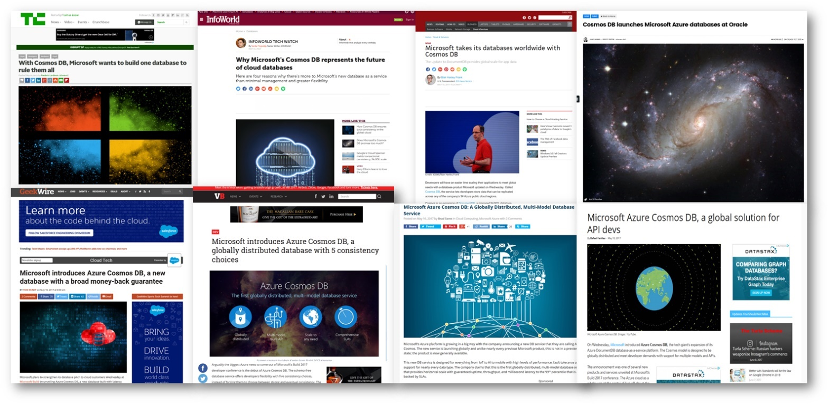
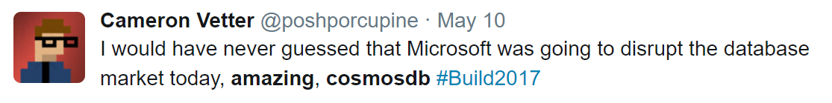
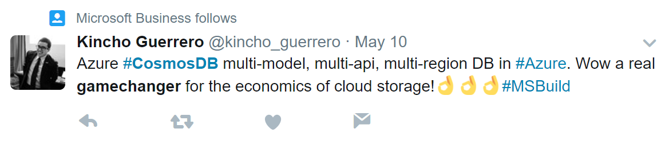
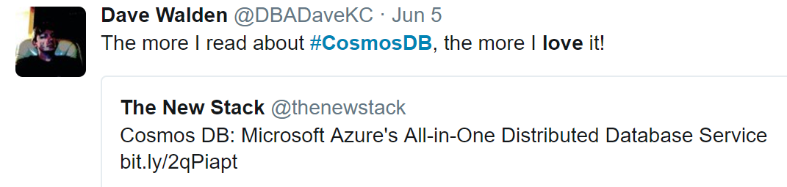

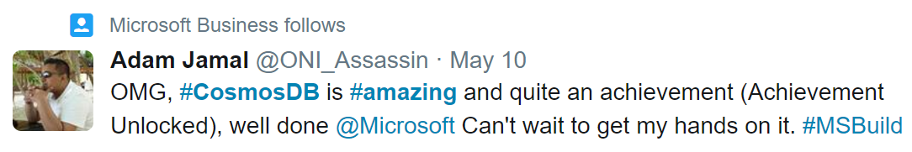

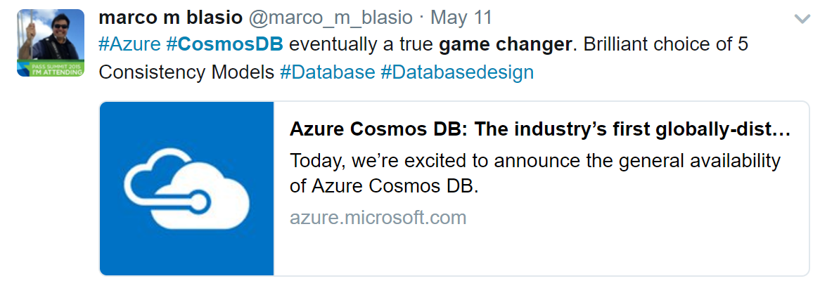

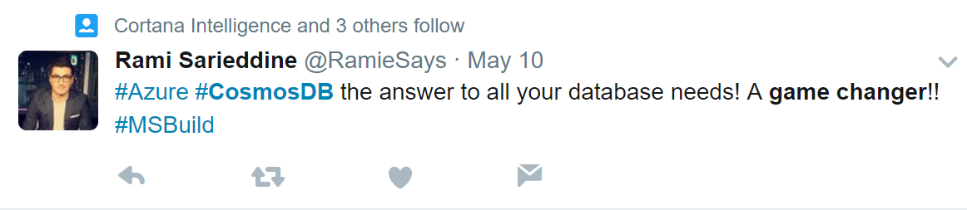
From validation to momentum
Overall
+27
32
Key Value
Wide Column
Document
Graph
3
+5
3
+1
5
+5
2
+2
Notes:
Full general Release in May 2017
Rating
Becoming very popular.

Slide 6
What sets Azure Cosmos DB apart
Notes:
Dive into the feature capabilities

Slide 7
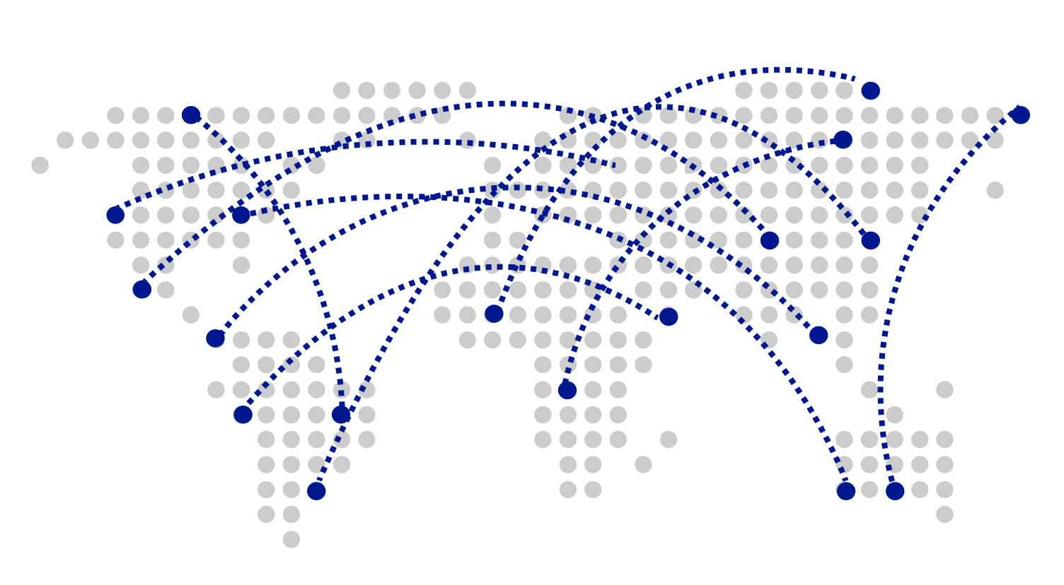
Turnkey Global Distribution
Worldwide presence as a Foundational Azure service
Automatic multi-region replication
Multi-homing APIs
Manual and automatic failovers
Designed for High Availability
Notes:
Cosmos DB is a Foundational (Ring 0) Azure service
Available in all Azure regions by default, including sovereign/government clouds
Transparent and automatic multi-region replication
Associate any number of regions with your database account, at any time
Policy based geo-fencing
Multi-homing APIs
All endpoints are logical, by default
Apps don’t need to be redeployed during regional failover
Apps can also access physical endpoints if needed
Support for both manual and automatic failover
Designed for high availability
Allows for dynamically setting priorities to regions
Simulate regional disasters via API
Test the end-to-end availability for the entire app (beyond just the database)

Slide 8
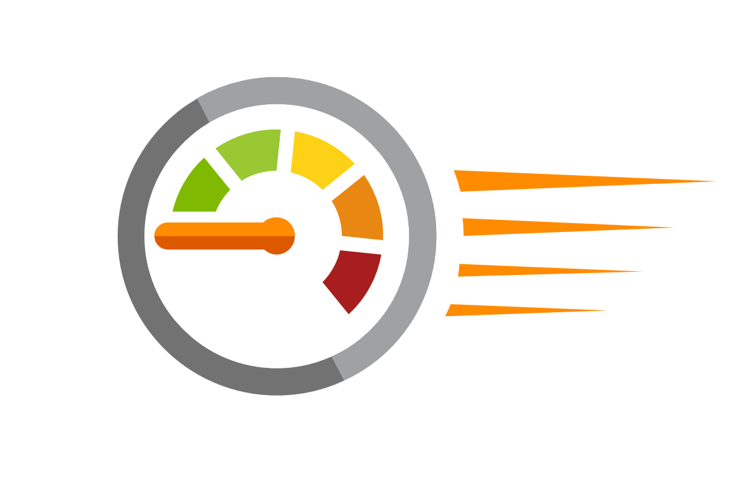
Guaranteed low latency at P99 (99th percentile)
Requests are served from local region
Single-digit millisecond latency worldwide
Write optimized, latch-free database engine designed for SSD
Synchronous automatic indexing at sustained ingestion rates
Reads
(1KB)
Indexed writes
(1KB)
P50
<2ms
<6ms
P99
<10ms
<15ms
Notes:
Unique design of the quorum based replication protocol
Globally distributed with reads and writes served from local region
Well defined consistency models designed to provide precise consistency guarantees
Unique design of database engine
Write optimized, latch-free database engine designed for SSDs and low latency access
Culmination of decades of database system research in marrying the best of NoSQL techniques for the write path with the Relational query optimized data structures concurrent btree on the read/query path
Benchmarked to have the lowest write and read amplifications.
Better performance and TCO compared to all popular log structured engines LevelDB, RocksDB, TokuDB, WiredTiger
Fully resource governed NO WRITE PAUSES
Synchronous and automatic indexing at sustained ingestion rates
No schema or index management needed
No schema versioning needed
No schema migration needed
All of this is highly relevant for rapidly evolving apps in a globally distributed setup
Cosmos DB guarantees low latency access by serving reads and writes from the local regions. This helps your applications to beat the speed of light or network latency across regions.
Nucleus of Cosmos DB is a write optimized, latch-free database engine which is designed for Solid State Drives. The core design point is low latency and performance and global scale.
Cosmos DB indexes all your data automatically, synchronously at sustained ingestion rates. There is no overhead of secondary indexes as with other databases. Most of us know the pain of managing indexes. Now imagine for a moment maintaining, managing, migrating indexes at global scale. It is almost impossible but with Azure Cosmos DB, you don’t have to. At P99 Cosmos DB guarantees <10ms latency for read access and <15ms for write access. Most applications will experience even lower latency of under <2ms for reads and <6ms for writes.
Several of our large scale cloud services at Microsoft uses Cosmos DB for low latency access. All the device telemetry from windows mobile devices is stored in a globally distributed database and with 100s of millions of devices out there, low latency was a key factor in deciding on the right data store.
CoHost application and Databases
Really good with concurrent writes.

Slide 9
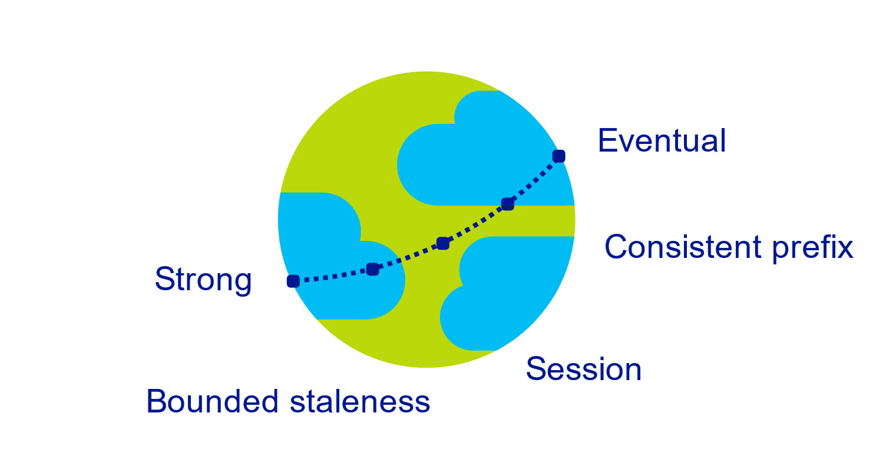
Multiple, well-defined consistency choices
Global distribution forces us to navigate the CAP theorem
Writing correct distributed applications is hard
Five well-defined consistency levels
Intuitive and practical with clear PACELC tradeoffs
Programmatically change at anytime
Can be overridden on a per-request basis
Notes:
Databases are divided into two categories
Provide extreme choices – strong vs. eventual consistency (e.g., DynamoDB)
Leave everything for developers to configure (e.g., Cassandra)
Read repair, Hinted handoff, quorum sizes, replication topologies etc
Developers have to make precise tradeoffs between
Consistency and availability (during failures)
Consistency and latency (during steady state)
Consistency and throughput (this is important for TCO reasons)
Strong
Bound staleness
Session
Consistent prefix : ordering guarantee
Eventual

Slide 10

Elastically scalable storage and throughput
12000000
10000000
8000000
6000000
4000000
2000000
Black Friday
Single machine is never a bottle neck
Transparent server-side partition management
Elastically scale storage (GB to PB) and throughput (100 to 100M req/sec) across many machines and multiple regions
Automatic expiration via policy based TTL
Pay by the hour, change throughput at any time for only what you need
Provisioned request / sec
Nov 2016
Dec 2016
Time
Hourly throughput (request/sec)
Notes:
Single machine is never a bottleneck
A single table can scale from GB-PBs, across many machines, and regions
Transparent server side partition management and routing
Optionally evict old data using built-in support for TTL
Customers pay only for the throughput and storage they need
Elastically scale throughput from 10 to 100s of millions of requests/sec across multiple regions
Customers pay only for the throughput and storage they need
Customers pay by the hour for the provisioned throughput

Slide 11
Schema-agnostic, automatic indexing
At global scale, schema/index management is painful
Automatic and synchronous indexing
Hash, range, and geospatial
Works across every data model
Highly write-optimized database engine
Schema
Physical index
Notes:
At global scale, schema/index management is hard
Automatic and synchronous indexing of all ingested content - hash, range, geo-spatial, and columnar
No need to define schemas or secondary indices upfront
Resource governed, write optimized database engine with latch free and log structured techniques
Online and in-situ index transformations
Focus on inverted index

Slide 12
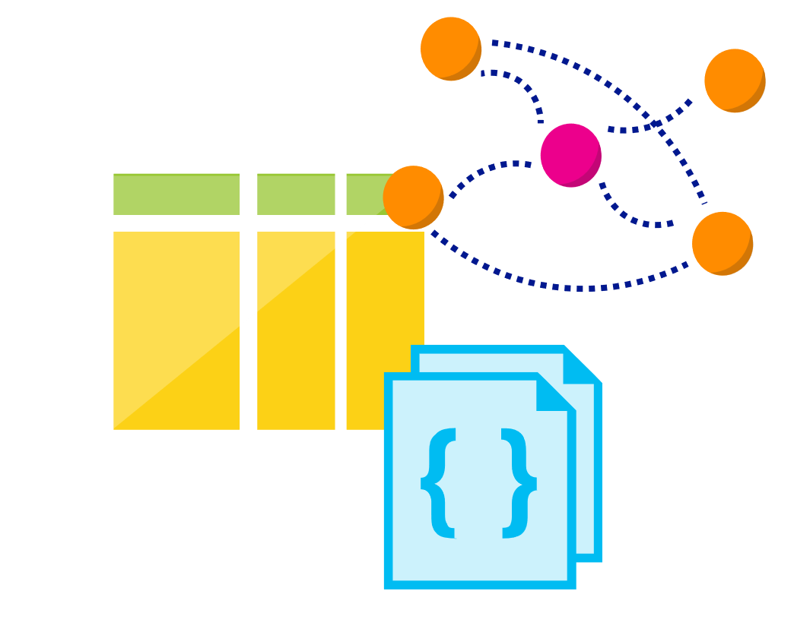
Multi-model, multi-API
Database engine operates on Atom-Record-Sequence type system
All data models can be efficiently translated to ARS
Multi-model: Key-value, Document, and Graph
Multi-API: SQL (DocumentDB), MongoDB, Table, and Gremlin
More data-models and APIs to be added
Notes:
Azure Cosmos DB natively supports multiple data models including documents, key-value, graph, and column-family. The core content-model of Cosmos DB’s database engine is based on atom-record-sequence (ARS). Atoms consist of a small set of primitive types like string, bool, and number. Records are structs composed of these types. Sequences are arrays consisting of atoms, records, or sequences.
The database engine can efficiently translate and project different data models onto the ARS-based data model. The core data model of Cosmos DB is natively accessible from dynamically typed programming languages and can be exposed as-is as JSON.
The service also supports popular database APIs for data access and querying. Cosmos DB’s database engine currently supports DocumentDB SQL, MongoDB, Azure Tables(preview), and Gremlin (preview). You can continue to build applications using popular OSS APIs and get all the benefits of a battle-tested and fully managed, globally distributed database service.
Can be on the exam

Slide 13
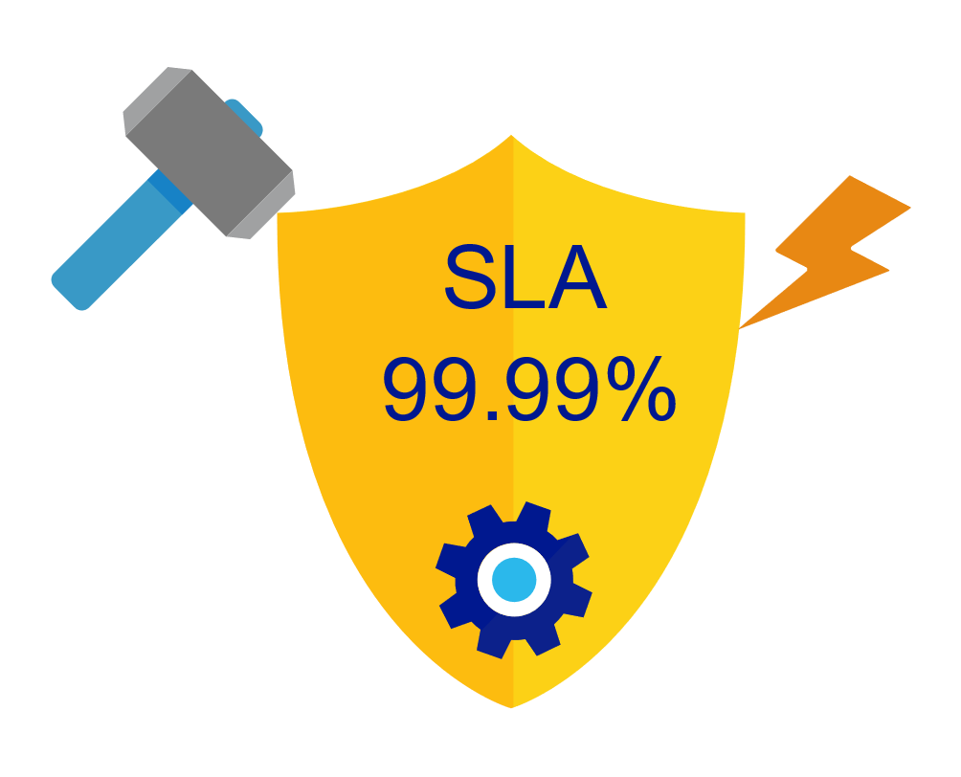
Industry-leading, enterprise-grade SLAs
99.99% availability – even with a single region
Made possible with highly-redundant storage architecture
Guaranteed durability – writes are majority quorum committed
First and only service to offer SLAs on:
Low-latency
Consistency
Throughput
Notes:
Globally distributed database needs to tackle
latency vs. consistency tradeoffs (in steady state)
availability vs. consistency tradeoff (during failures)
throughput vs. consistency tradeoffs during all times
throughput vs. latency tradeoffs during all times
Simply offering high availability SLAs are not sufficient!
Cosmos DB:
99.99% HA within a single region
99.99 SLA throughput, latency, consistency all at the 99th percentile
On the exam

Slide 14

Security & Compliance
Always encrypted at rest and in motion
Fine grained “row level” authorization
Network security with IP firewall rules
Comprehensive Azure compliance certification:
ISO 27001
ISO 27018
EUMC
HIPAA
PCI
SOC1 and SOC2
Notes:
As a foundational Azure Service, Security and Compliance is an important aspect of Azure Cosmos DB. Several high value Microsoft services that have stringent compliance and security requirements are built on Azure Cosmos DB. All of the data is encrypted at rest and it is enabled by default. We made sure that we continue to provide the performance guarantees even with encryption enabled and this is transparent to your application.
Biggest fear. What to stop others from getting all my data!
Why trust CosomDB
All cloud providers go thru a lot of rules to become security compliance
They require an Audit. To see how we do procedure. “Biggest security flow is not rotating the keys”
In addition to security features, these audits are coming in to make sure limit scope, encrypt and fuzzy out information, strict rules on how to manage data
List down the features, encrypt at rest…
Also how we keep up with audits.

Slide 15
Common Use Cases and Scenarios
Notes:
Demos can be found on www.DocumentDB.com/sql/demo
Refresh if it is not working

Slide 16


Globally Distributed Apps
Business Needs:
High scalability to support massive user base
Low latency access across multiple geographies to build highly responsive applications
Automatic indexing over flexible schemas to support rich queries over user-defined content (e.g. custom form builder)
High availability across multiple data centers
Notes:
Dot net nuke.
Focus on high availability, Promise guarantee to our customers. 99.999 variability. At most down for couple of minutes
Dominos’s has a very

Slide 17

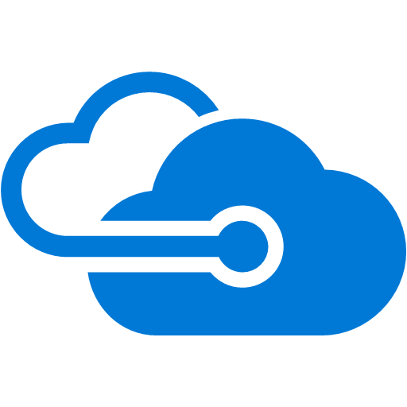

Content Management Systems
Azure region A
Azure Cosmos DB
(app + session state)
Azure region B
Azure Traffic Manager
Globally distributed
across regions
Azure region C
Notes:
Schema-less.
You can re-index, or drop column. As data comes in, we can re-index it.
Traffic Manager, what is it..
How many pizza, where is the pizza, apps connected

Slide 18





Internet of Things – Telemetry & Sensor Data
Business Needs:
High scalability to ingest large # of events coming from many devices
Low latency queries and changes feeds for responding quickly to anomalies
Schema-agnostic storage and automatic indexing to support dynamic data coming from many different generations of devices
High availability across multiple data centers
Notes:
How many are familiar with IOT?
Think of devices that farmer tracks, manufacturing sense cranes, engines and heat
And these are the companies that uses us
Why do they need to use us?
What DBs are being used?
Toyota has 250k Lexus sending information.
The data can change or capture different information
They need to be able to scale with throughput
Also schema less. So no need to create new tables or rows. Just add new info
We recommend having data access layer not to place all the load on the programmer
Also can add triggers to reject data if it doesn’t fit

Slide 19







Internet of Things – Telemetry & Sensor Data
Azure Data Lake (Cold)
Apache Spark on
Azure HDInsight
Azure Cosmos DB (Hot)
(TTL = 30 days)
Apache Kafka on
Azure HDInsight
Apache Storm on
Azure HDInsight
PowerBI
Azure Web App
Notes:
Spark-> Machine learning, Deeper insights,…
PowerBI-> Competitor Tablo.. Visualize the Data or use SQL reporting service
IOT is missing
Kafka is a data pipeline to queue in case of a failure
They double write. Why?
Because Azure Cosmos is built on SSD about $0.25 compared to $0.02
So hot data on CosmosDB and cold on Azure Data Lake
So expire the Data after 30 days on CosmosDB using TTL
Now we can connect to changeFeed feature. And allow it to expire

Slide 20




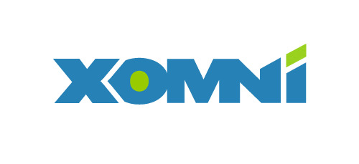
Retail – Product Catalog & Order Processing
Business Needs:
Elastic scale to handle seasonal traffic (e.g. Black Friday)
Low-latency access across multiple geographies to support a global user-base and latency sensitive workloads (e.g. real-time personalization)
Schema-agnostic storage and automatic indexing to handle diverse product catalogs, orders, and events
High availability across multiple data centers
Notes:
Why azure is so good with e-commerce? Because competitors are AWS
Because the seamless-schema
Old – only books
Multiple tables with columns for author…
Now I want to sell books. So either null values, or more tables
So more tables or one table with NULL values that is inefficient.
Now we can query and join many table with harry potter
So it will return all items with harry in the name, regardless of the product
Why cosmos DB exist.
A lot of seasonal traffic. Scaling up and down.

Slide 21

Retail Product Catalogs
Azure Web App
(e-commerce app)
Azure Cosmos DB
(product catalog)
Azure Search (full-text index)
Azure Storage
(logs, static catalog content)
Azure Cosmos DB
(session state)
Notes:
Front facing up for logic.
Azure storage: images, videos.. You don’t query on. Only the metadata.. Save it thru CDN to make it available to more regions
Sessions can be very important. The journey path. So we recommend it. We are JSON native DB
Azure Search is built on elastic search. Azure search has fuzzy search and show results if hary instead of harry

Slide 22




Retail Order Processing Pipelines
Azure Functions
(E-Commerce Checkout API)
Azure Cosmos DB (Order Event Store)
. . .
Azure Functions
(Microservice 1: Tax)
Azure Functions
(Microservice 2: Payment)
Azure Functions
(Microservice N: Fufillment)
Notes:
Dot jet are using it.
All things you do on jet.com goes to cosmosDB and it is logged as an event. Address in is an event.,
They all get stored, and the change feed goes to the worker load. So ex, take event and calculate taxes and put it back into cosmosDB
Another worker load will do the payment. So a manager takes tasks from one manager to another
After a week. You can expire everything.
Advantage of Microservice Architecture
Server-Less
Scale individually
Redeploy and manage separately updated
Easy to debug

Slide 23
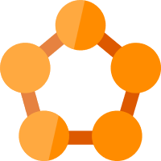



Real-time Recommendations
Online Recommendations Service (HOT path)
Azure Service Fabric
(Personalization Decision Engine)
Azure Cosmos DB
(distributed model store)
Shoppers
ASOS.com
(Product Details Page)
Azure Data Factory
(scheduled job to refresh persisted models)
Azure Event Hub
Azure Data Lake Storage
(offline raw data)
+
Apache Spark on Azure HDInsight
Offline Recommendations Engine (COLD path)
Notes:
ASOS triggers two events and got thru ASF and AEH
Use SPARK for ML training and pump in recommendations
USE cosmos DB for realtime and it is JSON so works great with web applications
Can be stored as table or graph.

Slide 24




Multiplayer Gaming
Business Needs:
Elastic scale to handle bursty traffic on day
Low-latency queries to support responsive gameplay for a global user-base
Schema-agnostic storage and indexing allows teams to iterate quickly to fit a demanding ship schedule
Change-feeds to support leaderboards and social gameplay
Notes:
Gaming have always been a big customers. Even one of the earlier on Document DB
Why?
A lot of people that are making the gaming are focused on the game itself.
Walking dead game, 7 people, we cant manage it. So lets use azure in the clouds.
Making a game for mobile has the risk of unknown spike, and can make or break the game
Fully managed and easy for them to use, can scale up for day one.
Not a good game is sec so they need milliseconds response from database

Slide 25




Multiplayer Gaming
Azure CDN
Azure Storage
(game files)
Azure Traffic Manager
Azure API Apps
(game backend)
Azure Cosmos DB
(game database)
Azure HDInsight (game analytics)
Azure Functions
Azure Notification Hubs
(push notifications)
Notes:
Whats the status of the player
Game analytics of who is the best in a region
Hubs to notifiy you that your friend is playing, or reminders

Slide 26



Customer 360 + Operational Analytics
Business Needs:
High scalability to handle large user base
Rich queries and automatic indexing over flexible schemas to consolidate data from a variety of sources
Built-in aggregates and efficient spark connector to analyze user behavior, drive insights, and build a single view of the customer.
Notes:
Save a lot of analytics information in cosmosDB because it is flexable
What revenue, rates
50-50 split that you might want to look at SQL with reporting
SQL is the GODfather of DB

Slide 27
Customer 360 + Social Analytics
1st-Party and 3rd-Party
Data Sources
Azure Cosmos DB
(Master Data)
Spark on
Azure HDInsight

Slide 28
Scale-out Computation
Spark SQL
Spark Streaming
GraphX (graph)
MLlib (machine learning)
Apache Spark on HDInsight
Scale-out Database
Spark Connector using DocumentDB API
Azure Cosmos DB
Notes:
How does cosmosDB connecto the Spark
So a spark connector, can connect every partition to the backend.
Not that you need equal mapping. They need mapper node to even distribute
So a very intelligent connector that can connect all of this.

Slide 29

Messaging
Business Needs:
High scalability to ingest and store messages from a massive user base
Low latency access across multiple geographies to support global user-base
High availability across multiple data centers
Notes:
Messaging is another big thing
Need to be schema-less
Skype needs low latency
Also great replications

Slide 30
Messaging
Week 0
Azure Cosmos DB
(message data – partitioned by userid)
Azure Search
(full-text index)
Azure Web App
(messaging app)
Notes:
Partition the Data
They didn’t use TTL
So they parse it out

Slide 31
Messaging
Week 0
Azure Cosmos DB
(message data – partitioned by userid)
Azure Search
(full-text index)
Week 1
Azure Web App
(messaging app)
Azure Cosmos DB
(message data – partitioned by userid)
Azure Search
(full-text index)

Slide 32
Messaging
Week 0
Azure Cosmos DB
(message data – partitioned by userid)
Azure Search
(full-text index)
Week 1
Azure Web App
(messaging app)
Azure Cosmos DB
(message data – partitioned by userid)
Azure Search
(full-text index)
Week 2
Azure Cosmos DB
(message data – partitioned by userid)
Azure Search
(full-text index)
Notes:
So they delete it
And it is the fastest way of droping a bunch of data.

Slide 33
